Slide 1

Pharma Mind : AI for smarter
Drug Discovery
Aditya Rawat(22106022)
Varun Raut(22106106)
Pratik Redekar(22106029)
Sarang Sawant(22106080)
Project Guide
Prof. Monali Korde

Slide 2
Outline
Introduction
Literature Survey of the existing systems
Limitations of the existing systems
Problem statement
Proposed System
Experimental Setup(Details about input/ dataset, Performance evaluation parameters, Software and hardware setup)
Implementation(Screenshots of all modules)
Conclusion and future work
References

Slide 3
Introduction
Drug discovery is the process of identifying new medicines that can treat diseases safely and effectively. It’s a long, complex, and expensive process that combines biology, chemistry, pharmacology, data science, and clinical research.
1. Target Identification & Validation
Find and confirm biological molecule linked to disease
Example: EGFR protein is overexpressed in cancer and blocking it reduces tumor growth
2. Hit Identification
Find small molecules that interact with target
Example: Screen compounds that bind to EGFR kinase
3.Hit-to-Lead Development
Refine hits to improve potency and selectivity
Example: Select compounds that strongly inhibit EFGR but not other kinases.
6. Clinical Trials & Regulatory Approval
Test in humans(Phases I- III)
Submit to FDA/EMA for approval
5. Preclinical Testing
Test in cells/animals for safety and efficiency
Example: EGFR inhibitor tested in cancer mouse models
4. Lead Optimization
Chemically modify leads to improve safety ,stability Example: Modify structure to enhance oral absorption of EFGR inhibitors

Slide 4
Introduction
These are some basic terminologies to better understand SBDD
1. Protein
A large biological molecule made of amino acids, folded into a 3D structure. Many diseases are caused when proteins malfunction (too active, too weak, mutated, etc.).So proteins are often the drug target - the molecule we want to control or "fix".
2. Ligand
A small molecule (drug, metabolite, ion, inhibitor, etc.) that can bind to a protein. In drug discovery: The ligand is the drug candidate .We design, screen, and optimize ligands to make them bind strongly and specifically to the target protein.
3. Pocket (Binding Site)
Proteins are not flat - they have cavities, grooves, or "pockets" on their surface.These are the active sites or binding sites where ligands fit (like a key into a lock). In drug discovery:We identify pockets on the protein where ligands can bind efficiently

Slide 5
Introduction
Drug discovery today is a slow, expensive, and high-risk process.
Average cost to develop a new drug: $2–3 billion.
Average time: 10–15 years.
Current methods rely on:
Wet-lab experiments → costly, time-consuming.
Traditional computational models → often oversimplify molecules, losing structural details.
Persistent issues:
High failure rate in clinical trials.
Difficulty in predicting toxicity, binding affinity, and side effects early.
Limited ability to process the vast chemical space (~10⁶⁰ possible drug-like molecules).

Slide 6
Motivation:
Observations that motivated this project:
Molecules are naturally graphs (atoms = nodes, bonds = edges).
Traditional ML/DL models use hand-crafted features (fingerprints, descriptors), which miss relational details.
Graph Neural Networks (GNNs), especially Graph Convolutional Networks (GCNs), can directly learn from molecular graphs, preserving atomic interactions.
Objectives:
To preprocess molecular datasets and represent them as graphs.
To design and train a GCN model for predicting drug properties or classifications.
To evaluate the model’s performance against existing baselines.
To build a scalable pipeline that can be extended to real-world drug discovery.

Slide 7
Literature Survey
Existing Solutions:
Classical ML (QSAR, fingerprints): simple, interpretable, but miss relational patterns.
Deep learning on SMILES: RNN/Transformers capture sequential patterns, but ignore full graph structure.
Graph Neural Networks : treat molecules as graphs → improved property prediction.
Industry Platforms (e.g., Atomwise): use AI-driven virtual screening at scale.
Key Issues in Existing Solutions:
Data scarcity & class imbalance in drug activity datasets.
SMILES & 2D models miss stereochemistry/3D effects.
GNN/3D models are compute-intensive and data-hungry.
Lack of interpretability → chemists/regulators find them “black-box”. Poor generalization to new chemical scaffolds (domain shift).

Slide 8
Literature Survey
Name of the research paper | Authors | Published on | Summary | Idea Adopted
Knowledge-augmented Graph Machine Learning for Drug Discovery: A Survey | Zhong, Barkova, Mottin | Feb 16, 2023 | Reviews graph ML with biomedical knowledge. | Guided our approach of using graph-like data (molecular structures) for better prediction.
Deep Lead Optimization: Leveraging Generative AI for Structural Modification | Zhang et al | Apr 30, 2024 | Uses deep generative models to refine existing drug candidates with subgraph generation. | Train models with protein pocket + ligand features so the AI learns how structural changes affect binding
Deep Learning in Drug Discovery: An Integrative Review and Future Challenges | Heba Askr, Enas Elgeldawi | Nov 17, 2022 | Surveys deep learning applications in drug discovery and highlights future challenges. | Provided the motivation to apply deep learning models like GNNs in our project.

Slide 9
Name of the research paper | Authors | Published on | Summary | Idea Adopted
Artificial Intelligence and Machine Learning in Drug Discovery and Development | Veer Patel, Manan Shah | August 2022 | Shows how AI/ML make drug development faster, cheaper, and more efficient. | Influenced us to use ML to reduce trial-and-error in early drug discovery.
Artificial Intelligence in Drug Discovery: Applications and Techniques | Jianyuan Deng, Zhibo Yang | Nov 3, 2021 | Explains AI techniques for predicting molecular properties and generating new molecules. | Helped shape our feature extraction and molecular property prediction steps.
DeepGS: Deep Representation Learning of Graphs and Sequences for Drug–Target Binding Affinity Prediction | Xuan Lin | March 31, 2020 | Introduces a deep learning model that predicts drug–target binding by combining molecular graphs with protein sequences. | Inspired our project to merge graph features and sequence data for better predictions.

Slide 10
Limitations of Existing Systems
Classical ML (QSAR/fingerprints):
Handcrafted features → limited representation of molecular complexity.
Struggles with unseen scaffolds and novel chemistries.
SMILES-based DL models (RNNs/Transformers):
Miss full graph topology, stereochemistry & 3D conformation.
Sensitive to SMILES syntax variations.
Graph Neural Networks (GCN/MPNN):
Strong at structure learning, but data hungry.
Lack interpretability → “black box” decisions not trusted in pharma.

Slide 11
Problem Statement:
“To design and implement a Graph Neural Network (GCN)-based system for drug discovery that efficiently predicts molecular properties from graph representations of compounds, while addressing challenges of data quality, scalability, and interpretability.”

Slide 12
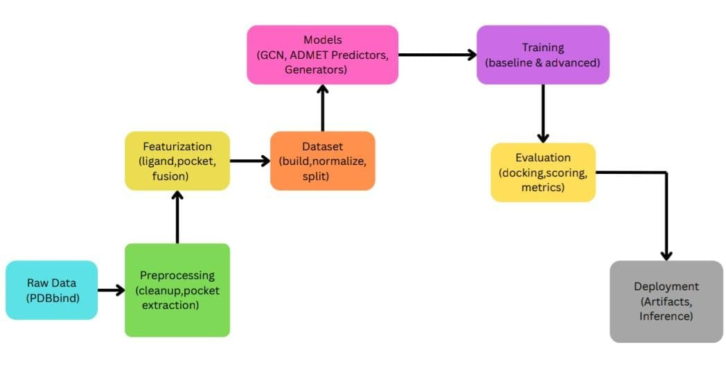
System Design

Slide 13
Technologies and methodologies
Technologies Used:
Core Libraries
NumPy, Pandas – Data preprocessing, numerical operations.
Scikit-learn – Baseline ML models, evaluation metrics.
Matplotlib, Seaborn – Data and result visualization.
Molecular Handling & Feature Extraction.
Biopython – Protein structure and binding pocket analysis .
Py3Dmol – 3D visualization of molecules.
Deep Learning Framework
PyTorch – Neural network framework.
Standard modules (useful for pretrained layers).

Slide 14
Graph Neural Network Framework
Torch-Geometric – Implement GCN, GAT.
Torch-Scatter(sparse update operations)
Data Handling & Utilities
Tqdm – Progress visualization during training.
Joblib, Pickle-mixin – Model saving/loading, serialization.
Jupyter/Notebook – Interactive environment for development.

Slide 15
Methodologies:
1. Data Preprocessing
Collect molecular datasets (PDBbind).
Convert SMILES → molecular graphs using RDKit.
Extract features:
  Node features (atomic number, valence, charge, aromaticity).
  Edge features (bond type, bond length).
2. Graph Neural Networks
GCN – Aggregate neighborhood atom information.
MPNN – Message passing to model molecular interactions.
3. Training & Evaluation
Loss: MSE/RMSE (regression).
Optimizer: AdamW with learning rate scheduling.
Metrics: R2(coefficient of determination)

Slide 16
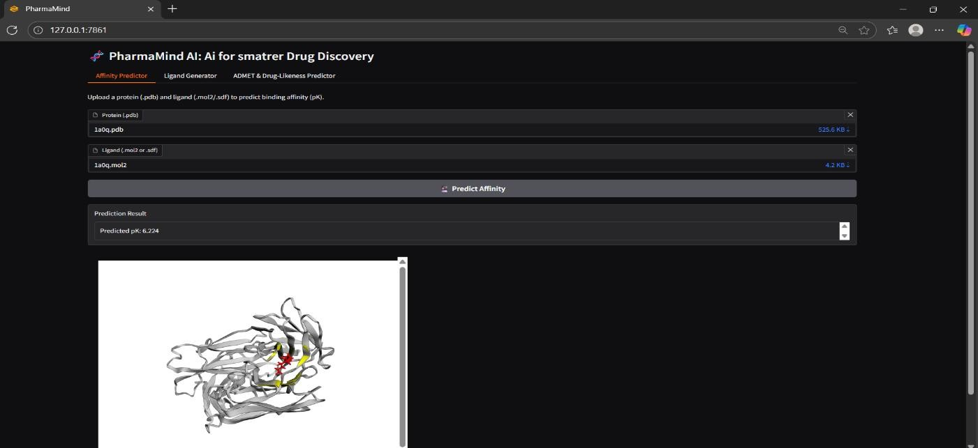
Implementation

Slide 17
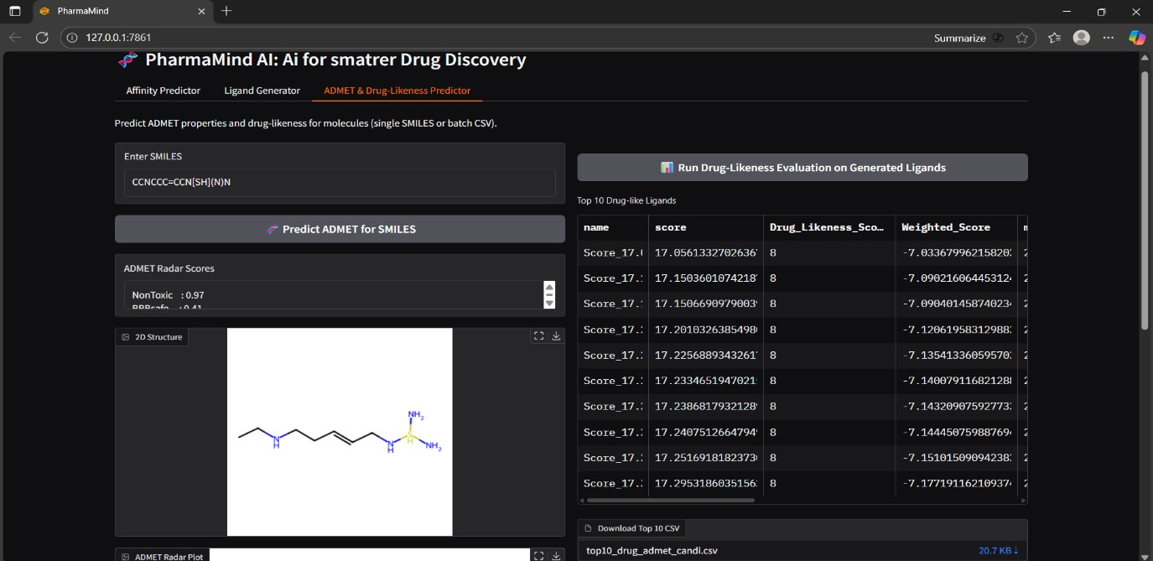
Expected Outcome

Slide 18
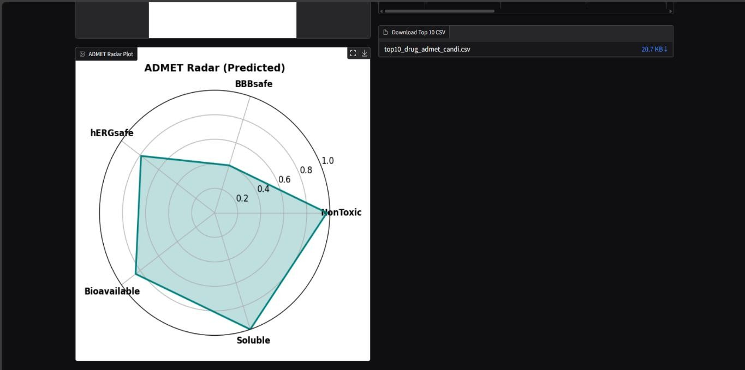

Slide 19
References
C. Fu and Q. Chen, “Artificial Intelligence in Drug Discovery and Development,” Journal of Pharmaceutical Analysis, vol. 15, no. 8, p. 101248, Aug. 2025. [Online]. Available: https://doi.org/10.1016/j.jpha.2025.101248
O. Zhang, H. Lin, X. Zhang, X. Wang, Z. Wu, Q. Ye, W. Zhao, J. Wang, K. Ying, Y. Kang, C.-y. Hsieh, and T. Hou, “Graph Neural Networks in Modern AI-aided Drug Discovery,” ArXiv preprint, Jun. 2025. [Online]. Available: https://arxiv.org/abs/2506.06915
“From Lab to Clinic: How Artificial Intelligence (AI) Is Reshaping Drug Discovery Timelines and Industry Outcomes”, Pharmaceuticals (MDPI), Jun. 2025. [Online]. Available: https://doi.org/10.3390/ph18070981
“Artificial Intelligence in Drug Discovery and Development: Transforming Challenges into Opportunities”, Discover Pharmaceutical Sciences, Jun. 2025. [Online]. Available: https://doi.org/10.1007/s44395-025-00007-3
“Integrating Artificial Intelligence in Drug Discovery and Early Drug Development: A Transformative Approach”, Biomarker Research, Mar. 2025. [Online]. Available: https://doi.org/10.1186/s40364-025-00758-2
“Advancing Drug Discovery with Deep Attention Neural Architectures”, Advanced Drug Delivery Reviews, Oct. 2024. [Online]. Available: https://www.sciencedirect.com/science/article/pii/S1359644624001922
M. Besharatifard and F. Vafaee, “A Review on Graph Neural Networks for Predicting Synergistic Drug Combinations,” Artificial Intelligence Review, vol. 57, art. 49, Aug. 2024. [Online]. Available: https://link.springer.com/article/10.1007/s10462-023-10669-z
“Knowledge Mapping of Graph Neural Network Applications in Drug Discovery”, PMC, Mar. 2024. [Online]. Available: https://www.ncbi.nlm.nih.gov/pmc/articles/PMC11116974/

Slide 20
SDG Goals
1. SDG 3: Good Health and well Being
Goal: Developing new treatments faster helps combat diseases and improve global health outcomes.
2. SDG 9: Industry, Innovation and Infrastructure
Goal: Our AI platform drives scientific and technological innovation in the pharmaceutical industry.
3. SDG 17: Partnerships for the Goals
Goal: Our technology facilitates collaborations that strengthen the means of implementation and revitalize global partnerships for sustainable development.

Slide 21
Thank You...!!

